Slide 1



Full Stack Developer
Judul Mission : Mission 3A
Disusun oleh : Efan Yacha R - 16026
Email : efanyacha@gmail.com
Restricted - For Student Only

Slide 2
Link GitHub :
https://github.com/efanyacha/Mission-3A-Basic-Full-Stact-Development-HariSenin.com-Batch-16.git

Slide 3
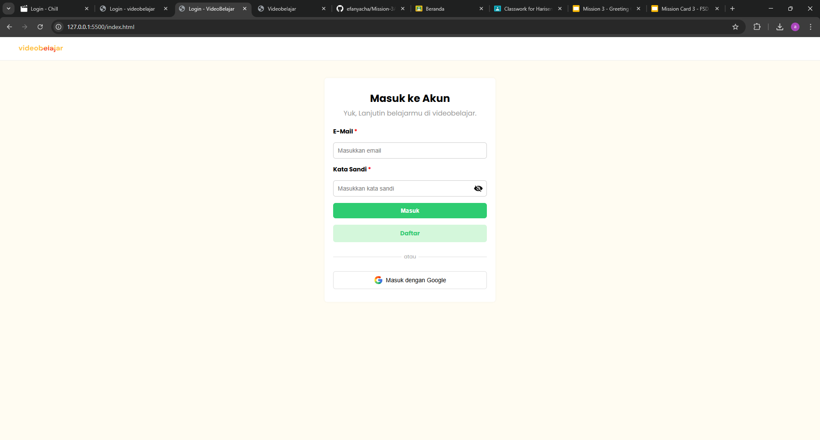
Page Login :

Slide 4
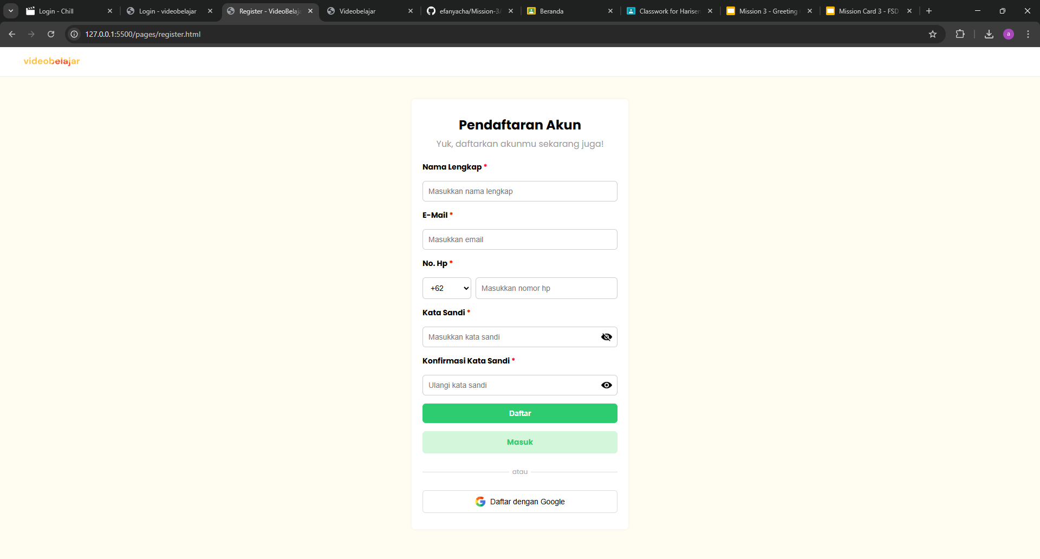
Page Register :

Slide 5

Page Beranda Part 1:

Slide 6
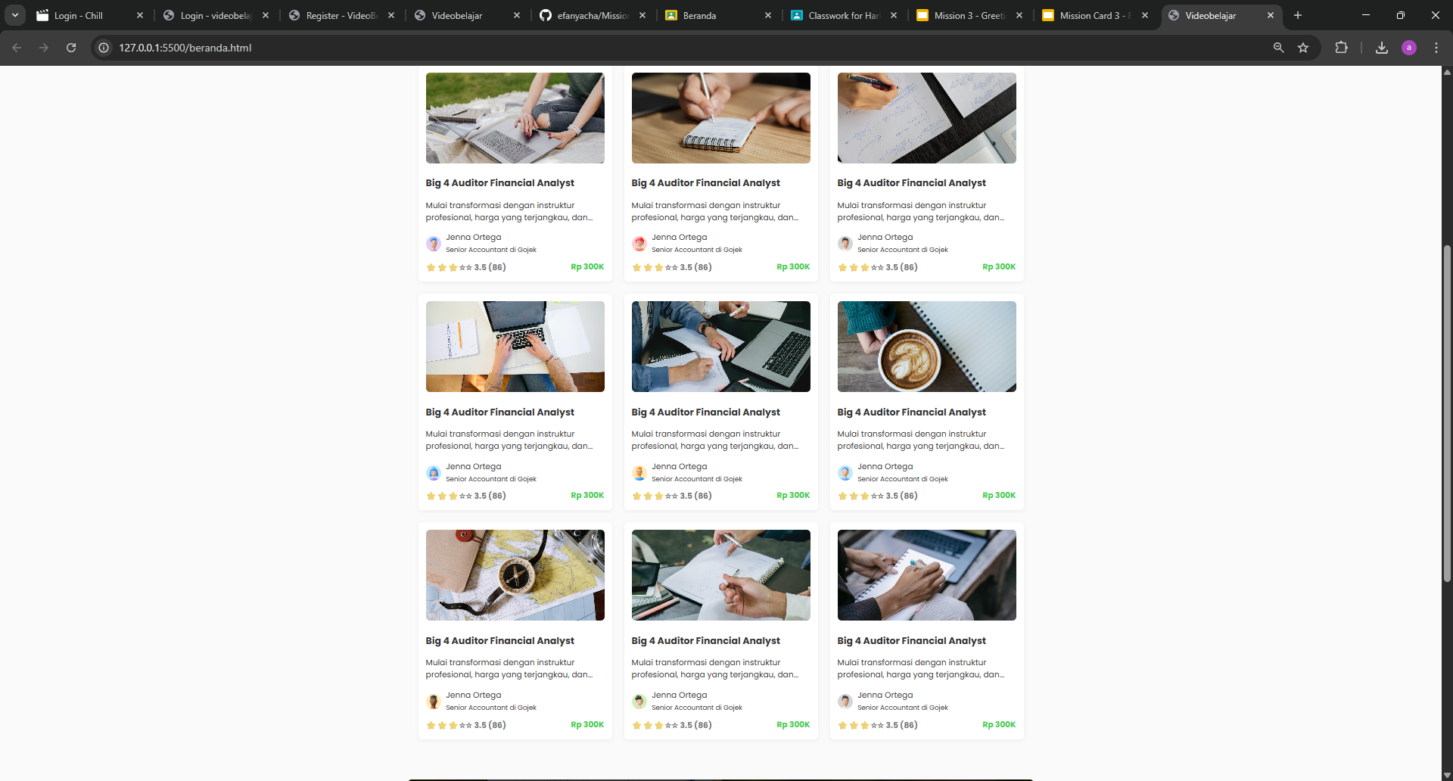
Page Beranda Part 2:

Slide 7
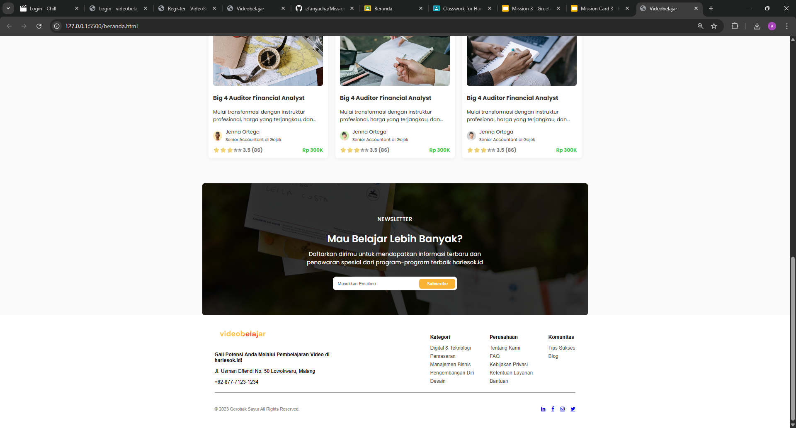
Page Beranda Part 3:

Slide 8
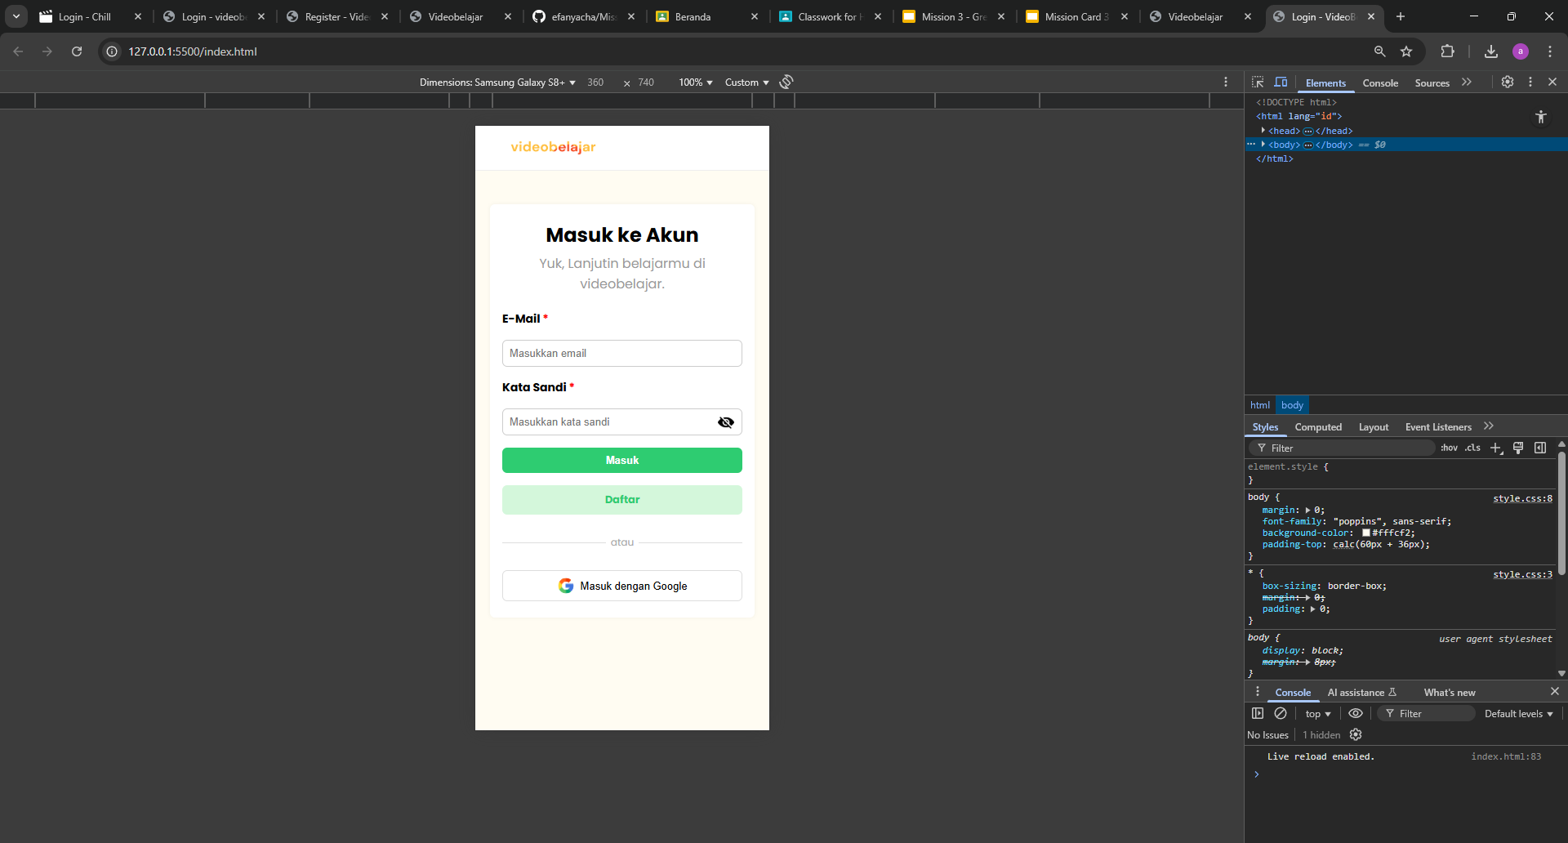
Page Login HP:
Page Login :

Slide 9
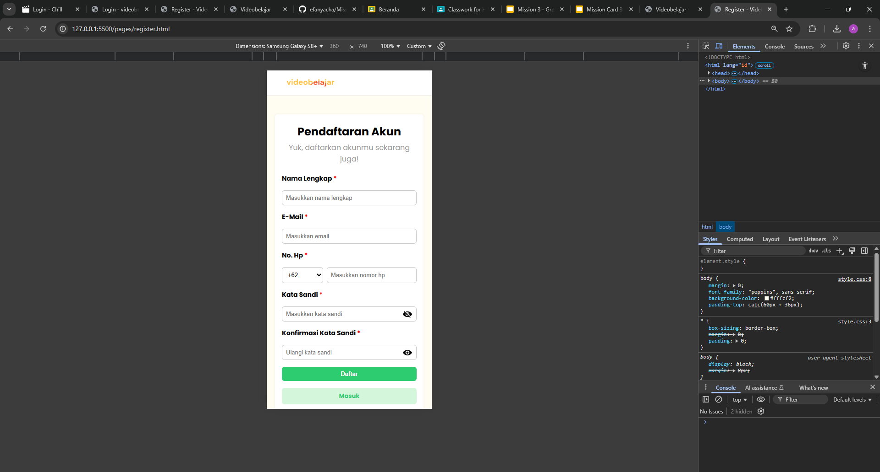
Page Register HP :

Slide 10
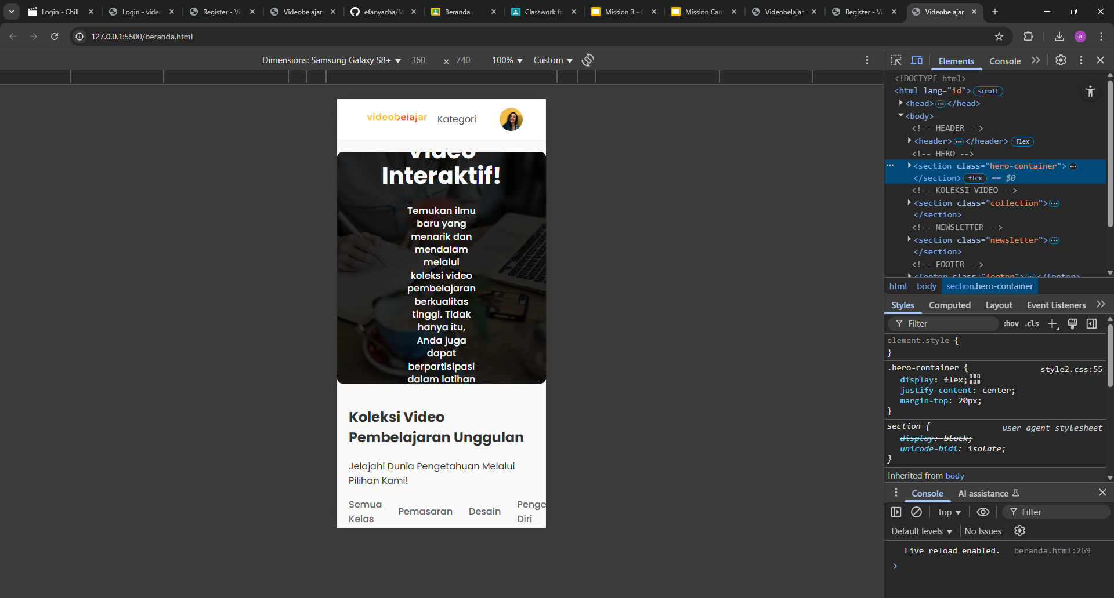
Page Beranda HP Part 1 :

Slide 11
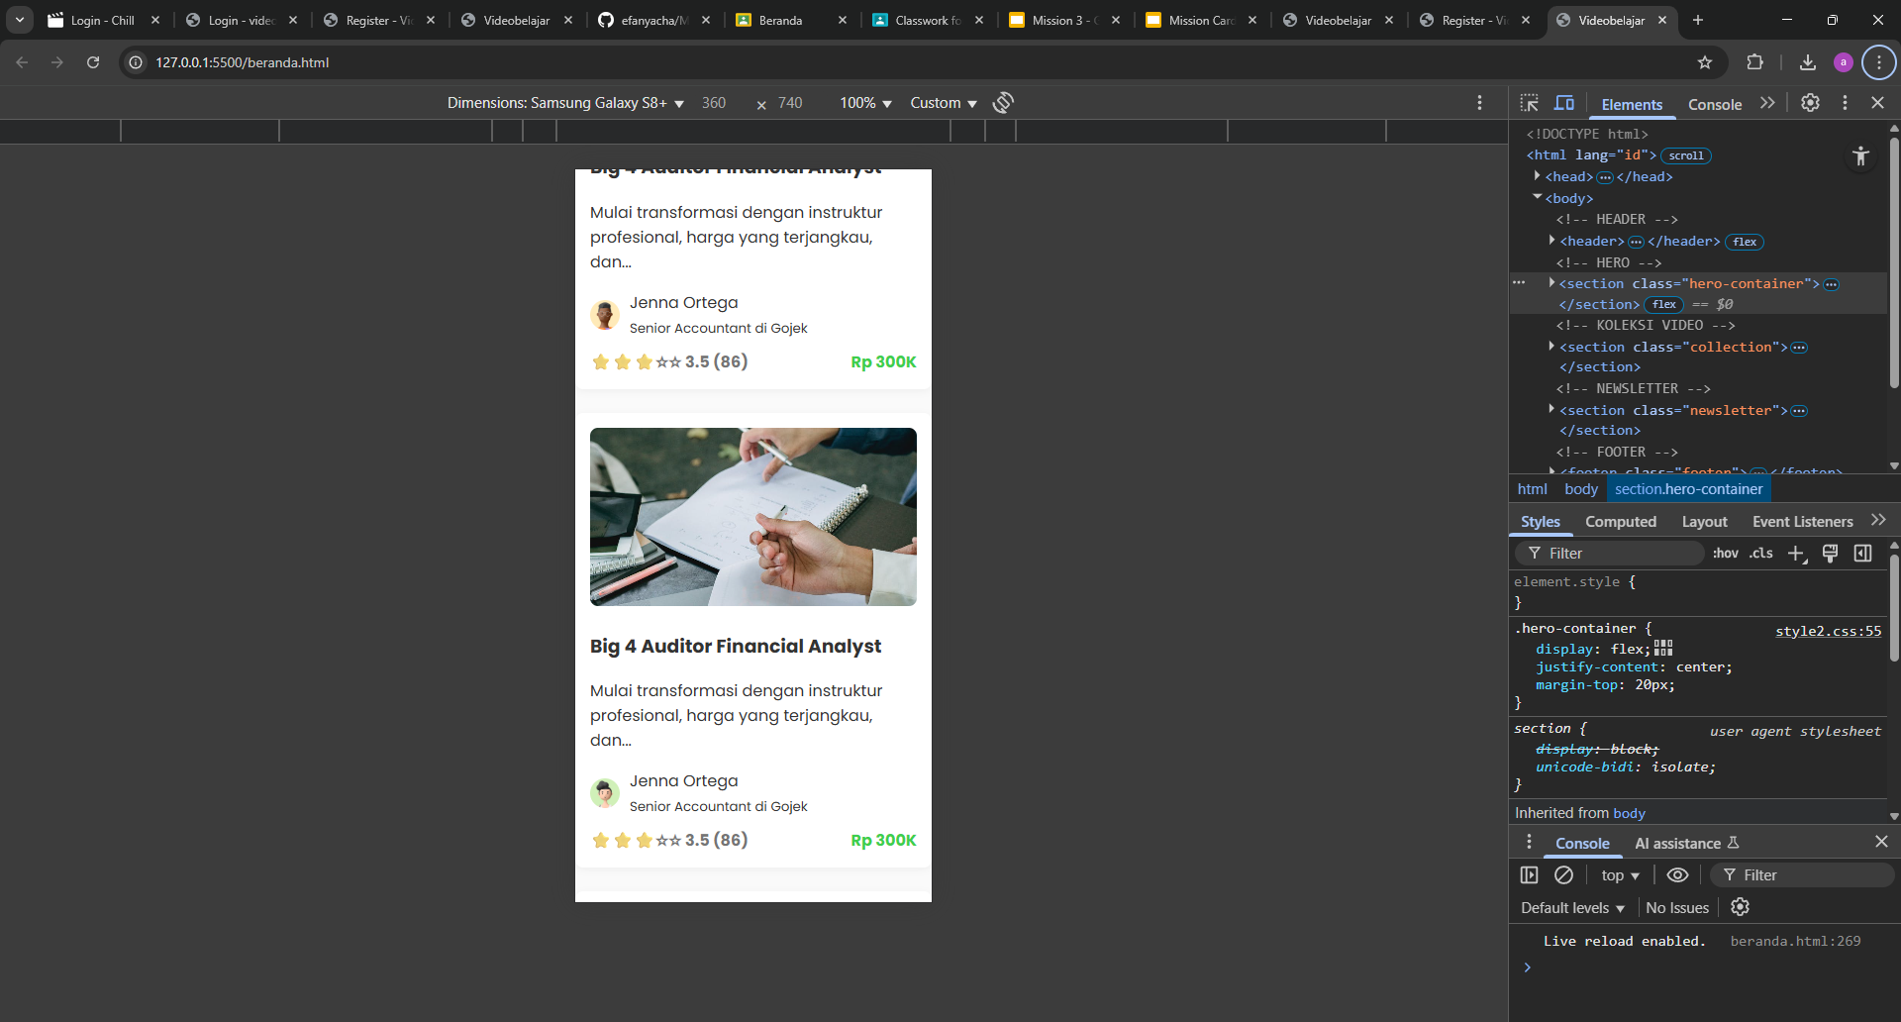
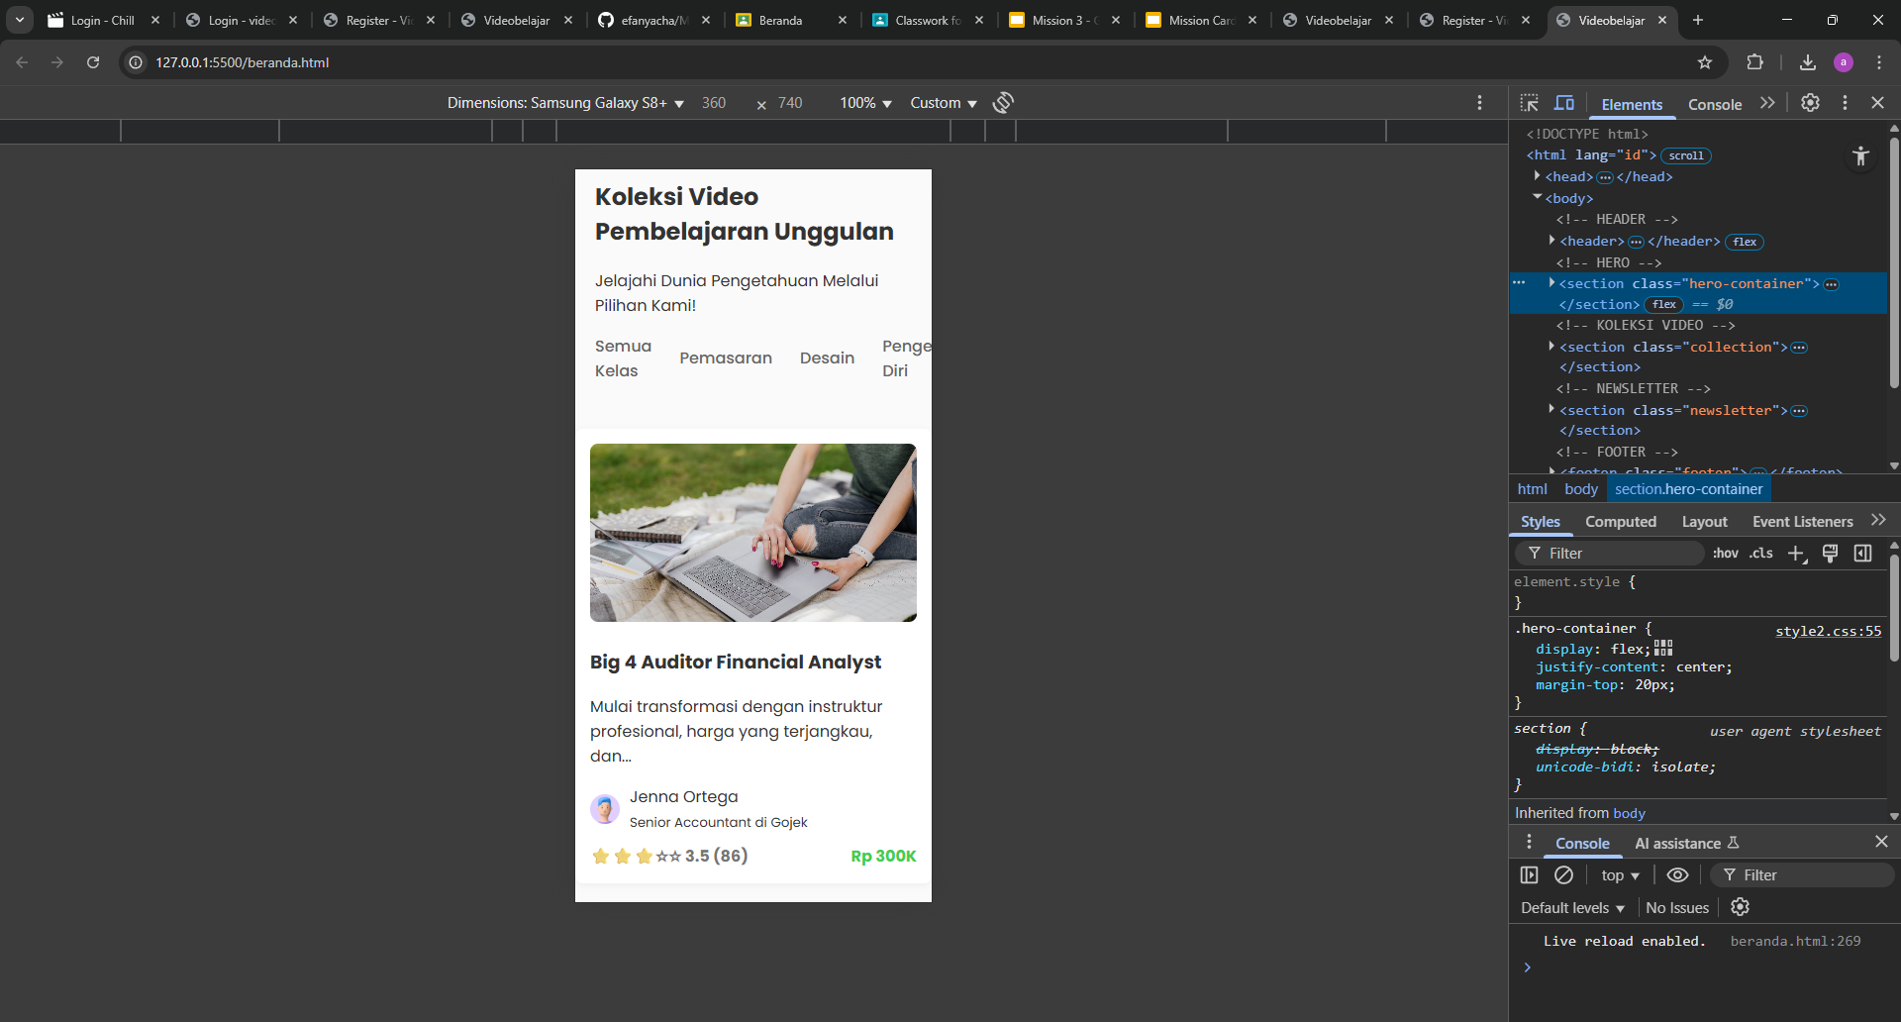
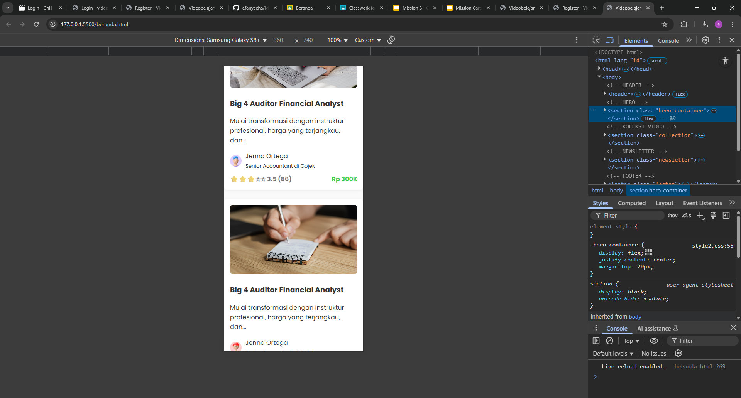
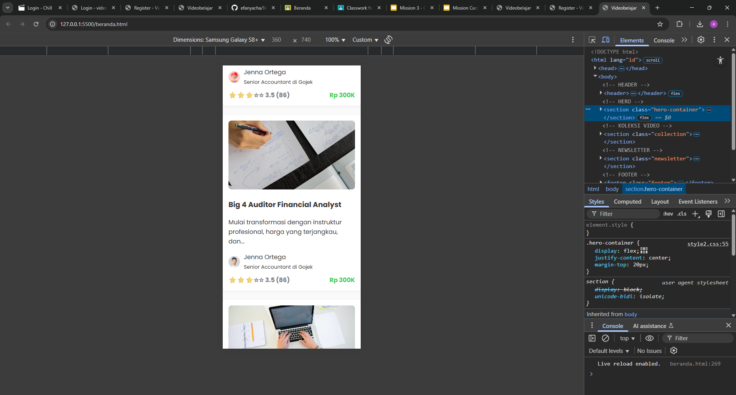
Page Beranda HP Part 2 :

Slide 12
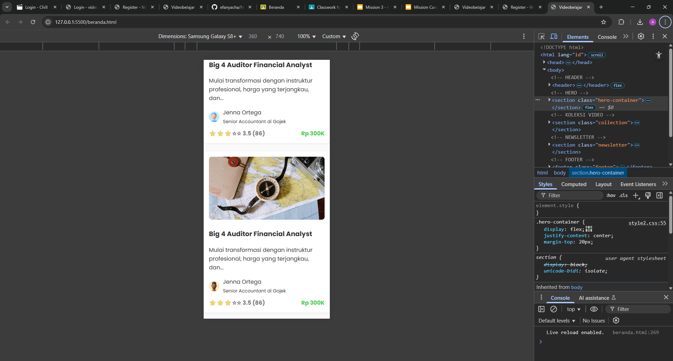
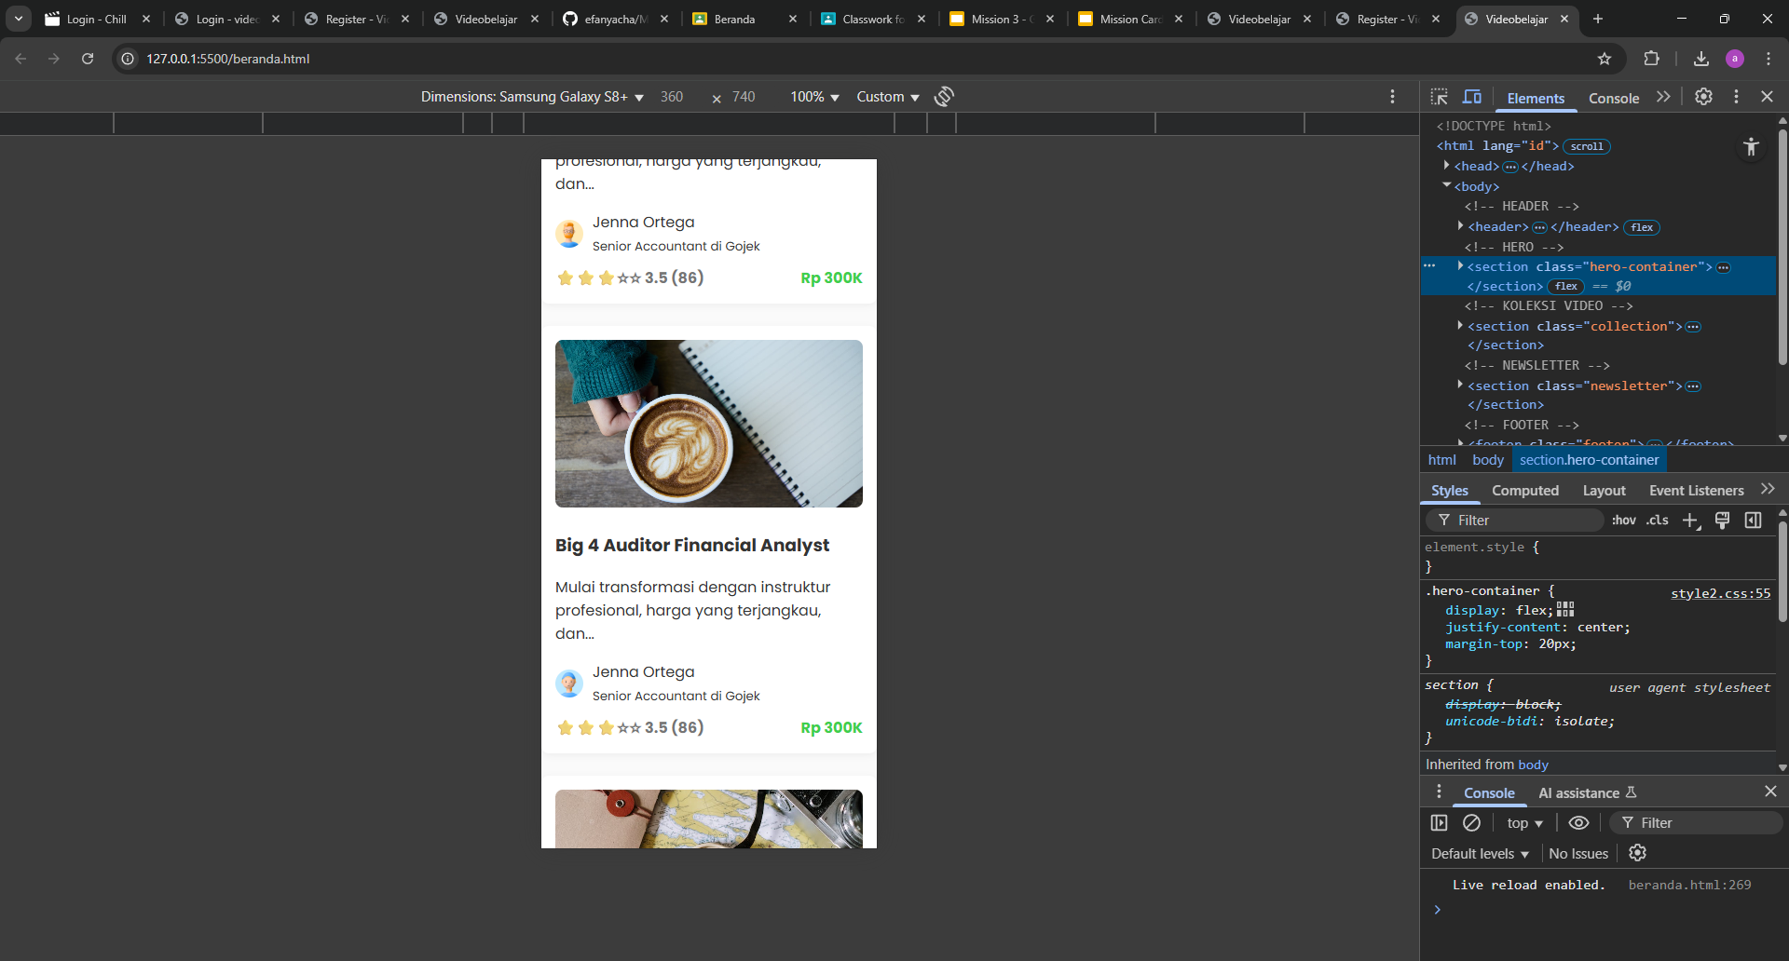
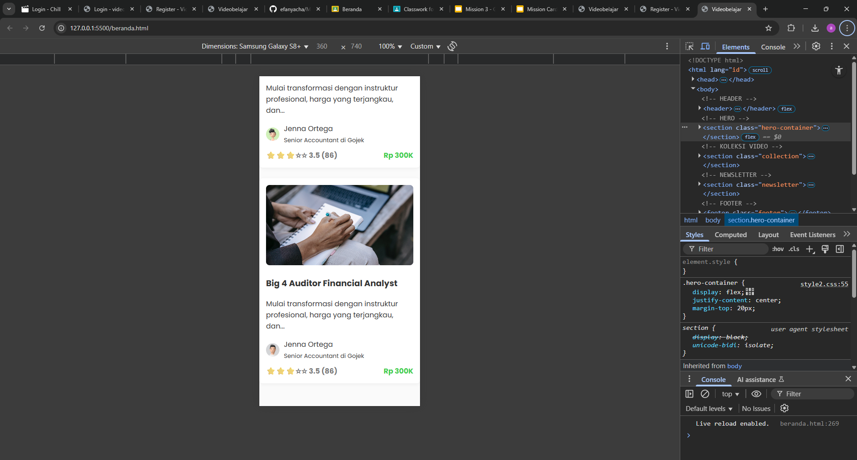
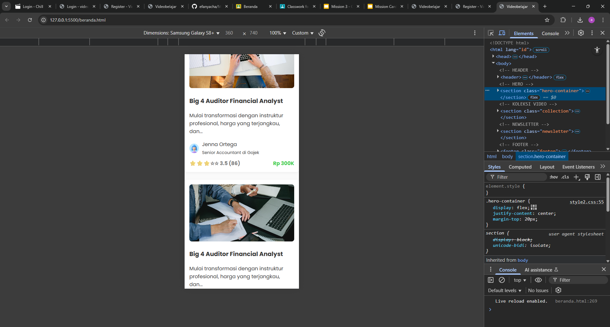
Page Beranda HP Part 3 :

Slide 13
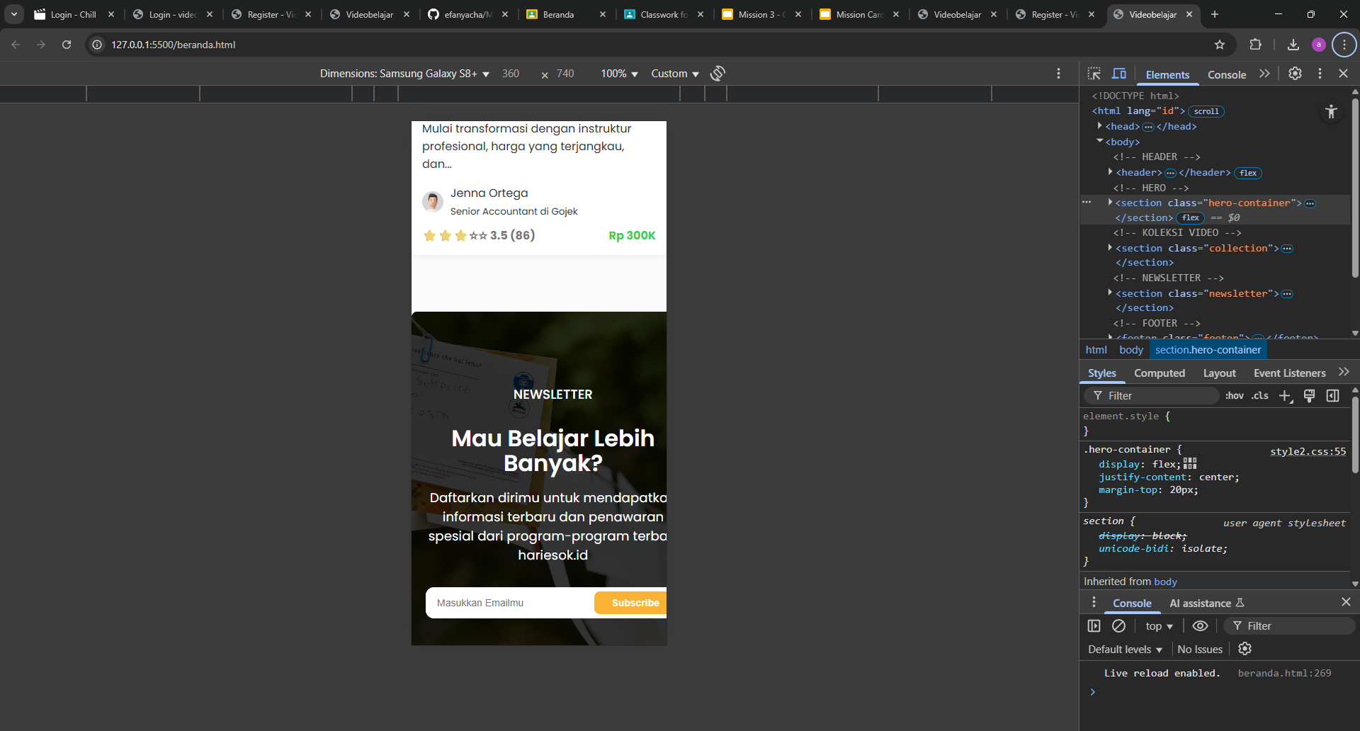
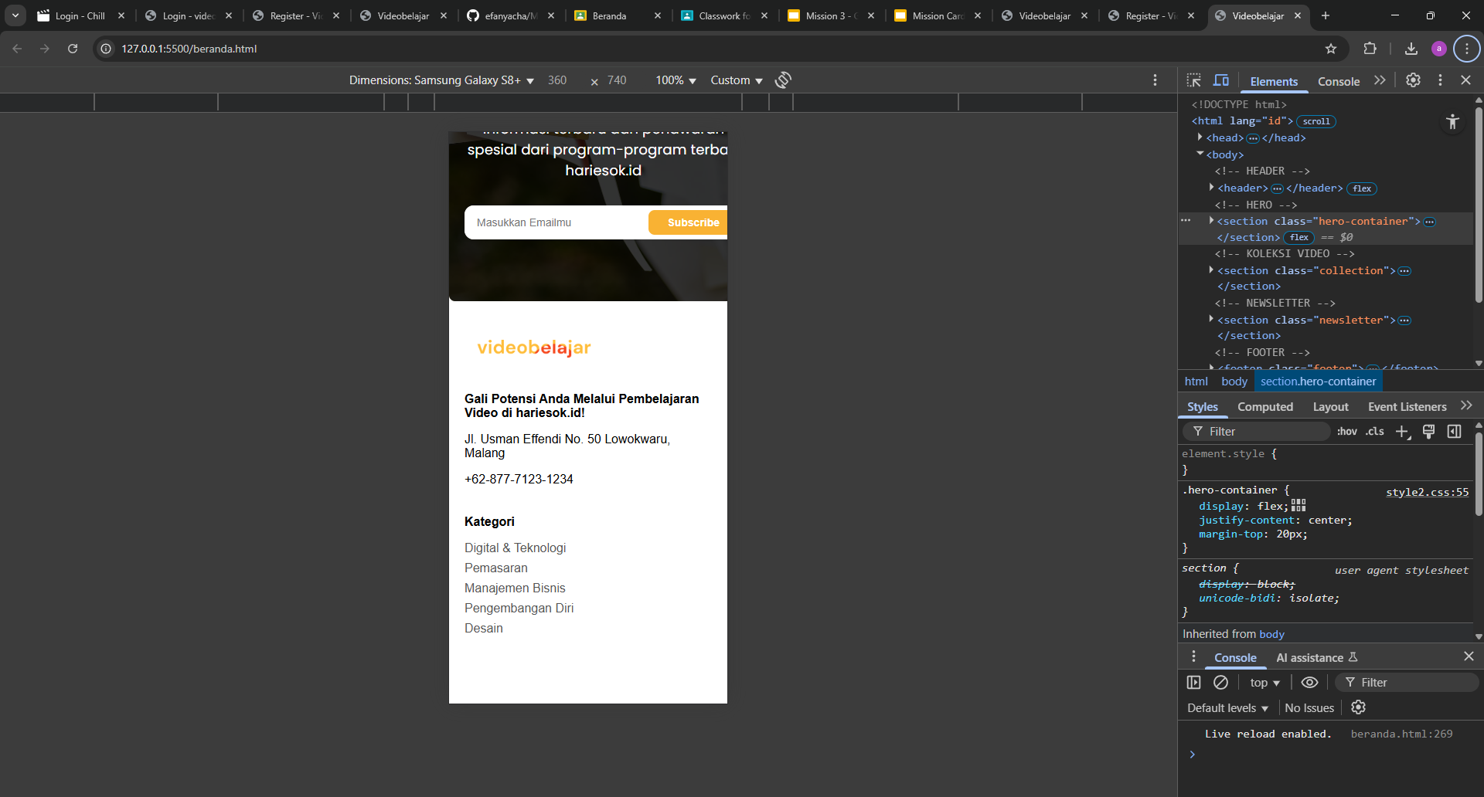
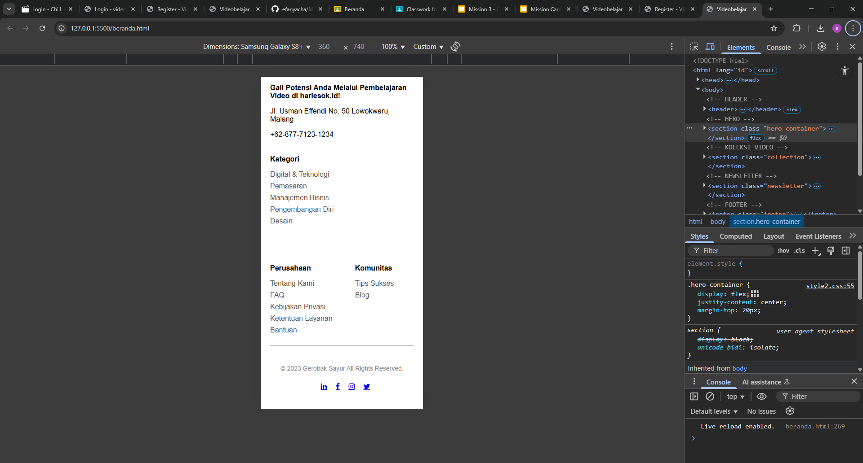
Page Beranda HP Part 4 :

